Slide 1
Fundamentals of Statistics & Probability

Slide 2
Trainer Guidelines for Conducting Class
Solve questions live by creating new blank files (Excel, Python, Jupyter notebook, Dashboard) during the session, rather than sharing completed solutions.
Review teaching materials and solutions beforehand, and prepare additional examples to reinforce learning.
Ensure online students can hear you and see the screen clearly at all times.
Test your computer and necessary software before class begins.
Check with online students every 15-20 minutes to see if they understand the material and have any questions.

Slide 3

Statistics Roadmap
Advanced Statistic & Hypothesis Testing
Day 2
Fundamentals of Statistics & Probability
Day 1

Slide 4
Agenda
Define Statistics & Its Importance.
Types Of Data: Categorical And Numerical.
Inferential And Descriptive Statistics
Measure Of Central Tendency: Mean, Median, Mode.
Measure Of Dispersion: Variance & Standard Deviation
Probability Basics, It's Rules & Notation
Probability Distribution -Discrete & Continuous
Normal Distribution & Properties
Central Limit Theorem & Its Importance
Skewness & T-distributions

Slide 5

Define Statistics and Its Importance.

Slide 6
Introduction to Statistics
Definition
Statistics is the process of collecting, organizing, analyzing, interpreting, and presenting data to understand patterns and make informed decisions
The importance and significance of statistics lie in its ability to
Informs decisions
Manages uncertainty
Spotlights trends
Aids research
Ensures quality
Shapes policies
Drives business
Guides healthcare

Slide 7
The Decision-Making Process
Decision
Knowledge
Experience, Theory, Literature, Inferential Statistics, Computers
Information
Descriptive Statistics, Probability, Computers
Begin Here:
Identify the Problems
Data

Slide 8

Types Of Data: Categorical And Numerical.

Slide 9
Types of Data
Data Types
Qualitative (Categorical)
Quantitative
Ordinal (Ordered)
Nominal (not Ordered)
Continuous (Can be divided)
Discrete (Can’t be divided)
Example: Test Grade
Example: Nationality
Example: Distance
Example: Cats

Slide 10
Population & Sample
Population
The entire group you want to study.
Example: All households in a country for studying average income.
1
2
Sample
A smaller, representative subset from the population.
Example: Surveying a selected group of households to estimate average income, saving time and resources.
Population
Part of Population
Sample
Sample
Data under investigation
Sampling

Slide 11
Sampling Techniques
Simple Random Sampling:
In simple random sampling, every individual in the population has an equal chance of being selected.
This can be done using random number generators or a random process.
Stratified Random Sampling:
The population is divided into subgroups or strata based on certain characteristics (e.g., age, gender, income).
Random samples are then taken from each stratum in proportion to the population distribution.
3. Systematic Sampling:
Individuals are selected at regular intervals from a randomly chosen starting point.
For example, every 10th person on a list may be included in the sample.
4. Cluster Sampling:
The population is divided into clusters, and entire clusters are randomly selected.
Then, all individuals within the selected clusters are included in the sample.

Slide 12
Cont…
5. Convenience Sampling:
This method involves selecting individuals who are easiest to reach or obtain.
It is a non-probability sampling technique and may introduce bias.
6. Snowball Sampling:
In snowball sampling, existing study participants recruit future participants.
This method is often used when the population is hard to reach.
7. Purposive Sampling:
Also known as judgmental or selective sampling, purposive sampling involves selecting individuals based on specific characteristics.
This method is often used when researchers want to study a particular subgroup.
8. Quota Sampling:
Similar to stratified sampling, quota sampling involves selecting a predetermined number of individuals from each subgroup.
The difference is that the selection within each stratum is non-random.

Slide 13

Inferential And Descriptive Statistics

Slide 14
Types of Statistics
There are two main types of statistics
1. Descriptive Statistics
Involve summarizing and presenting data to describe its main features.
This includes measures such as mean, median, mode, range, variance, and standard deviation.
Descriptive statistics are used to gain insights into data and understand its characteristics.
2. Inferential Statistics
Involve making predictions, inferences, or generalizations about a larger population based on a sample of data.
includes techniques like hypothesis testing, confidence intervals, and regression analysis. Inferential statistics help us draw conclusions beyond the data we have collected.
These two types of statistics work together to help us analyze and understand data in a comprehensive manner.

Slide 15
Descriptive Statistics
Descriptive Statistics
Measure of Central Tendency
Measure of Dispersion
Mean
Mode
Range
Standard Deviation
Median
Variance
Interquartile Range (IQR)

Slide 16
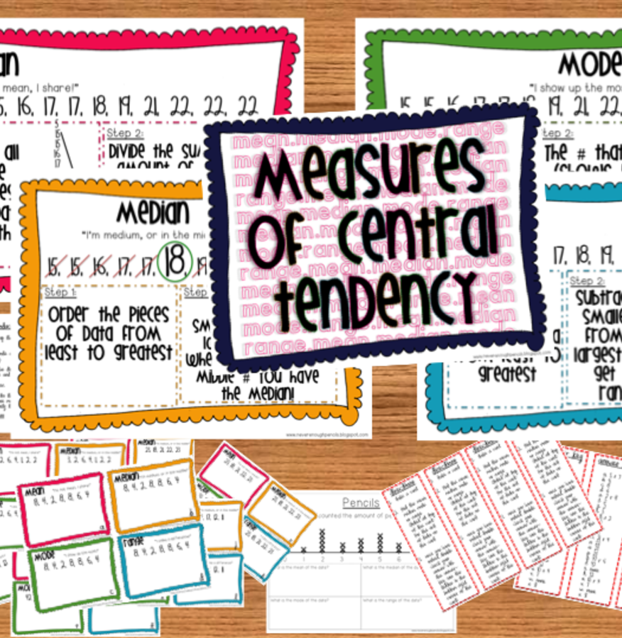
Measure Of Central Tendency: Mean, Median, Mode.

Slide 17
Measure of Central Tendency
Mean (Average)
Definition: The mean is the sum of values divided by the count of values.
Example: For the numbers 3, 5, and 7, the mean is (3 + 5 + 7) / 3 = 5.
Median
Definition: The median is the middle value when data is ordered.
Example: In the dataset 10, 20, 30, 40, 50, the median is 30.
Mode
Definition: The mode is the most frequent value in a dataset.
Example: In the dataset 5, 8, 8, 10, 12, 12, 12, the mode is 12 as it appears most frequently.

Slide 18

Cont..
Population Mean (Average)
The population mean is denoted by μ (mu) and is calculated as the sum of all values in the population divided by the total number of values in the population.
Where:
μ is the population mean.
Xi​ is the i-th value in the population.
N is the total number of values in the population.
$$μ=\frac{Σx_{i}}{N}$$

Slide 19

Cont..
Sample Mean (Average)
The sample mean is denoted by ˉXˉ (pronounced "X-bar") and is calculated as the sum of all values in the sample divided by the total number of values in the sample.
Where:
ˉXˉ is the sample mean.
xi​ is the i-th value in the sample.
n is the total number of values in the sample.
$$\overline{X}=\frac{\sum{x_{i}}}{n}$$

Slide 20
Outliers
Outliers & it’s effect on Mean, Mode & Median
Outliers are data points that deviate significantly from the rest of the data in a dataset.
Dataset = {10, 15, 20, 25, 30, 20}
Calculate Mean, Mode, and Median:
Mean: (10+15+20+25+30+20) / 6 = 20
Mode: The mode is 20, as it occurs more frequently than any other value.
Median: The median is (20 + 25) / 2 = 22.5.

Slide 21
Cont..
Dataset with Outlier: {10, 15, 20, 25, 30, 20, 200}
Calculate Mean, Mode, and Median with Outlier:
Mean: 10+15+20+25+30+20+200) / 6 ≈ 47.86
Mode: The mode is still 20, as it occurs more frequently than any other value.
Median: The median is 25. The middle position is determined by the order of values, and the outlier does not impact this calculation.

Slide 22
Cont..
Effect of Outliers
Mean: The mean increased again, but the mode remained the same.
Median: Not drastic change in the median. As before, the median is slightly (negligible) affected by the presence of the outlier.
Mode: The mode is not affected by the presence of the outlier because it is determined by the frequency of values, and 20 still occurs more frequently than any other value.
In summary, the mode remains the same even with the inclusion of an outlier, as it is determined by the frequency of values. The median is also unaffected, while the mean is sensitive to the extreme value and increases accordingly.

Slide 23

Measure Of Dispersion: Variance & Standard Deviation

Slide 24
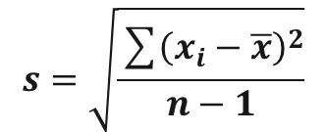
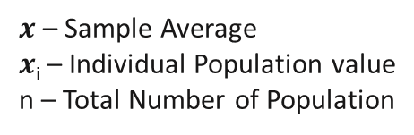
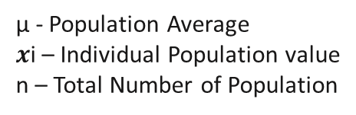
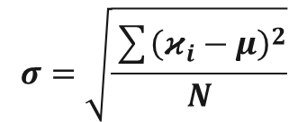
Measure of Dispersion
Range
Definition: The range is the difference between the highest and lowest values in a dataset.
Example: In the dataset {10, 15, 20, 25, 30}, the range is 30 - 10 = 20.
Standard Deviation
Definition: Standard deviation is a statistical measure of the amount of variation or dispersion in a set of values.
It indicates how much individual data points differ from the mean (average) of the data set
Example: In {12, 15, 18, 21, 24}, the standard deviation is approximately 4.5.
Population
Sample
$$σ=\sqrt{\frac{\sum{{\left(κ_{i}−μ\right)}^{2}}}{N}}$$
$$s=\sqrt{\frac{\sum{{\left(x_{i}−\overline{x}\right)}^{2}}}{n−1}}$$
µ - Population Average
$x$i – Individual Population value
n – Total Number of Population
$x$ – Sample Average
$x$_{i} – Individual Population value
n – Total Number of Population

Slide 25
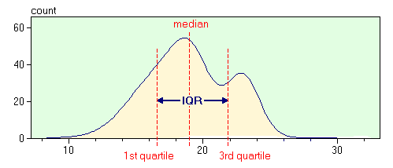
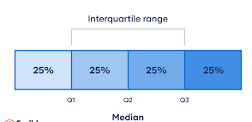
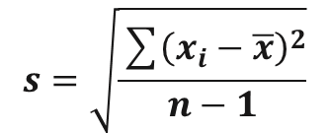
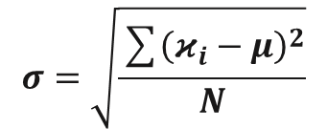
Cont...
Variance
Definition: Variance measures how data points differ from the mean by averaging the squared differences from the mean.
Example: In the dataset {5, 10, 15, 20, 25}, the variance is approximately 41.67.
Interquartile Range (IQR)
Definition: IQR is the range between the 75th and 25th percentiles, measuring the spread of the middle 50% of data.
Example: In {10, 20, 30, 40, 50}, the IQR is 40 - 20 = 20.
Population
Sample
$$σ=\sqrt{\frac{\sum{{\left(κ_{i}−μ\right)}^{2}}}{N}}$$
$$s=\sqrt{\frac{\sum{{\left(x_{i}−\overline{x}\right)}^{2}}}{n−1}}$$

Slide 26
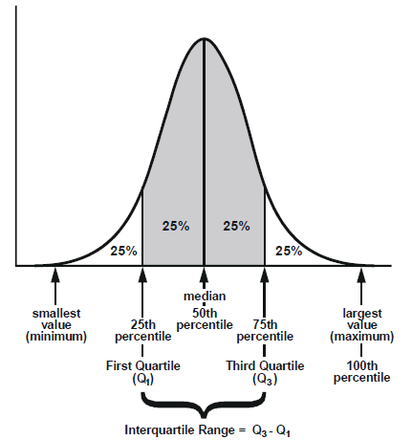
Cont...
The IQR is used to identify the range in which the middle 50% of the data values lie.
The formula for calculating the Interquartile Range (IQR) is as follows:
IQR = Q3 − Q1
the Interquartile Range is a robust measure of variability that focuses on the central 50% of the data, providing insights into the spread of the middle portion of a dataset.

Slide 27
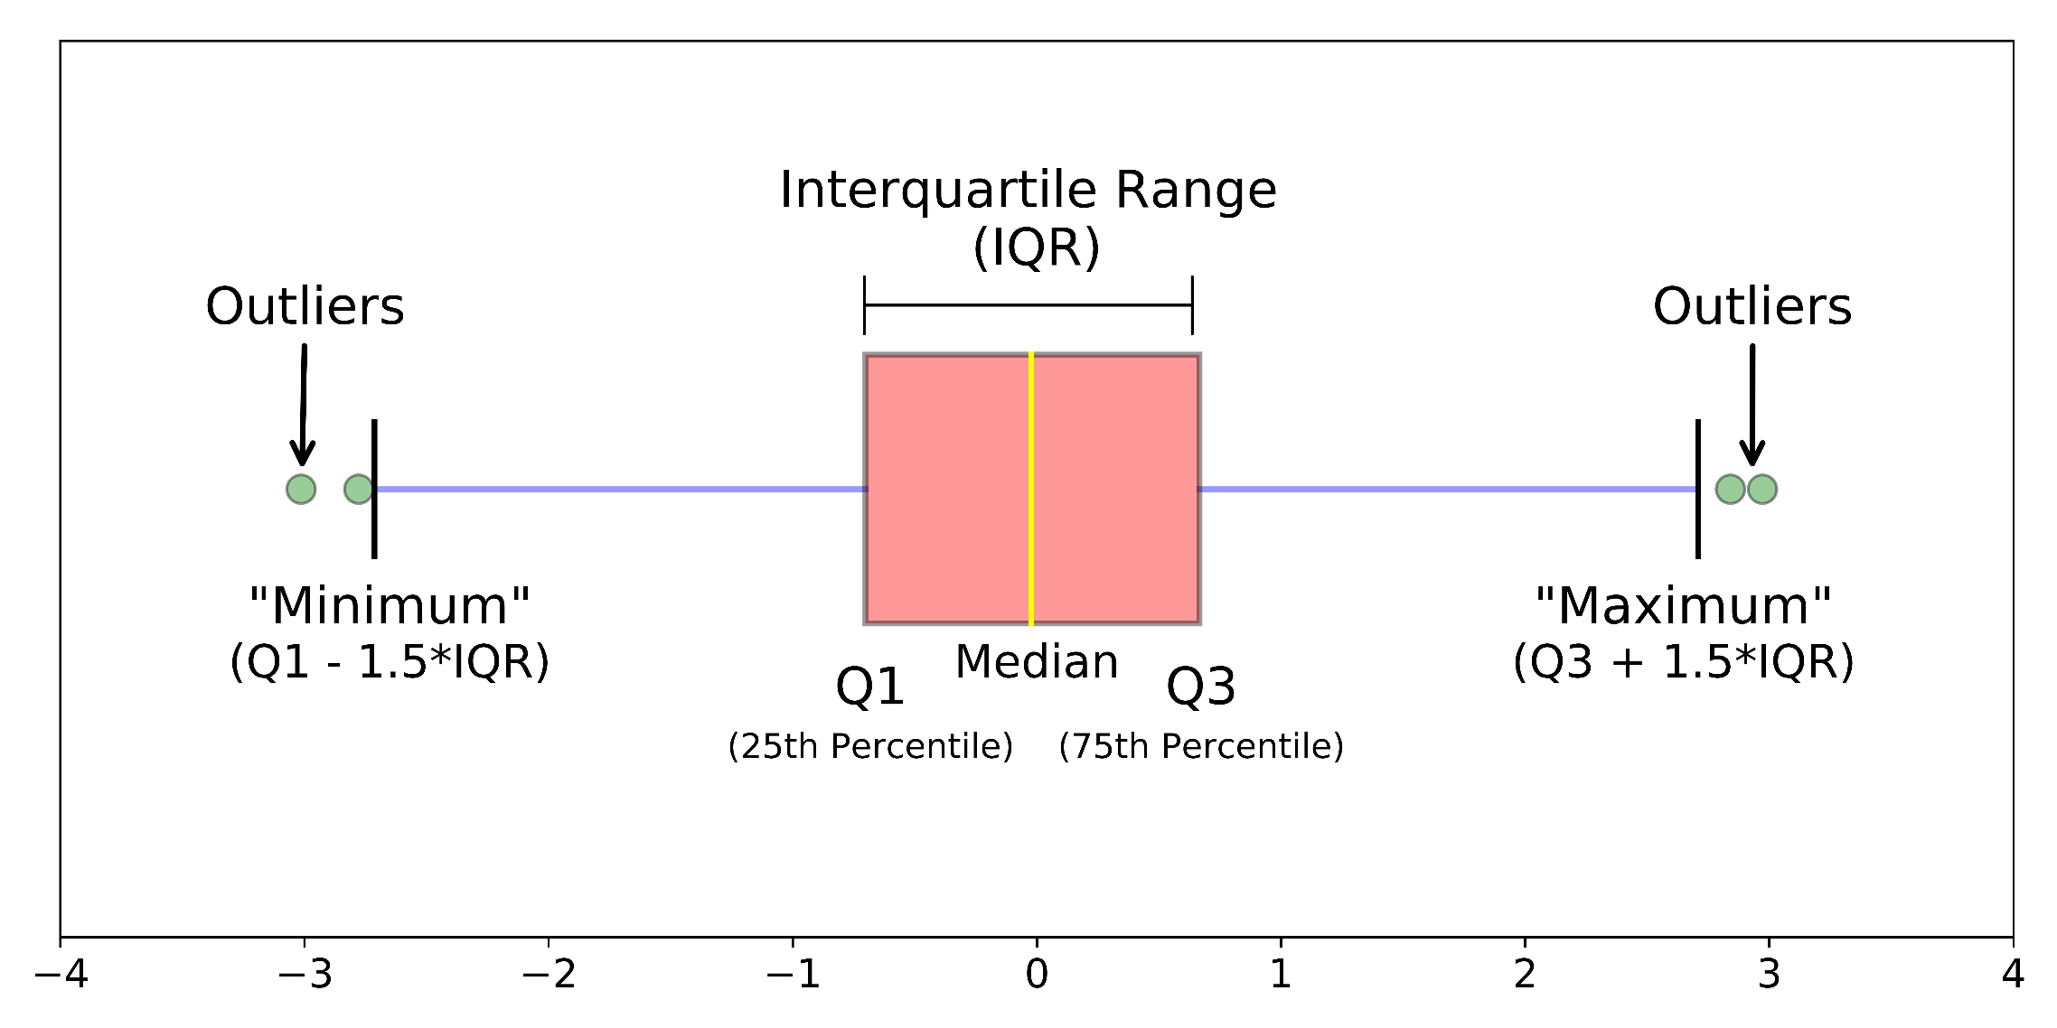
Cont...

Slide 28

Probability Basics, It's Rules & Notation

Slide 29
Probability
Definition of Probability
Probability is a measure of the likelihood of an event occurring. It is a number between 0 (indicating impossible) and 1 (indicating certain) that quantifies uncertainty.
Probability Rules
Addition Rule: The probability of either of two mutually exclusive events happening is the sum of their individual probabilities. P(A or B) = P(A) + P(B).
Multiplication Rule: The probability of both independent events happening is the product of their individual probabilities. P(A and B) = P(A) * P(B).
Complement Rule: The probability of an event not happening is 1 minus the probability of it happening. P(not A) = 1 - P(A).

Slide 30

Cont…
Question 1
You have a standard deck of 52 cards. What is the probability of drawing a red card (hearts or diamonds) from the deck?
Answer 1
The probability of drawing a red card is calculated as follows:
There are 26 red cards (13 hearts and 13 diamonds) out of 52 total cards.
So, P(Red Card) = Number of Red Cards / Total Number of Cards = 26/52 = 1/2.
In a standard deck of cards, half of the cards are red (hearts and diamonds) and half are black (spades and clubs). Therefore, the probability of drawing a red card is 1/2, or 50%.
Notes:
Answer 1:
The probability of drawing a red card is calculated as follows:
There are 26 red cards (13 hearts and 13 diamonds) out of 52 total cards.
So, P(Red Card) = Number of Red Cards / Total Number of Cards = 26/52 = 1/2.
Explanation 1:
In a standard deck of cards, half of the cards are red (hearts and diamonds) and half are black (spades and clubs). Therefore, the probability of drawing a red card is 1/2, or 50%.
Answer 2:
The probability of randomly selecting a green marble is calculated as follows:
There are 3 green marbles out of a total of 5 red + 4 blue + 3 green = 12 marbles.
So, P(Green Marble) = Number of Green Marbles / Total Number of Marbles = 3/12 = 1/4.
Explanation 2:
In this case, you have a bag with 12 marbles of different colors. To find the probability of selecting a green marble, you simply divide the number of green marbles by the total number of marbles in the bag. The probability of selecting a green marble is 1/4, or 25%.

Slide 31
Cont…
Question 2
You have a bag with 5 red marbles, 4 blue marbles, and 3 green marbles. What is the probability of randomly selecting a green marble from the bag?
Answer 2
probability of randomly selecting a green marble is calculated as follows:
There are 3 green marbles out of a total of 5 red + 4 blue + 3 green = 12 marbles.
So, P(Green Marble) = Number of Green Marbles / Total Number of Marbles = 3/12 = 1/4.
In this case, you have a bag with 12 marbles of different colors. To find the probability of selecting a green marble, you simply divide the number of green marbles by the total number of marbles in the bag. The probability of selecting a green marble is 1/4, or 25%.
Notes:
Answer 1:
The probability of drawing a red card is calculated as follows:
There are 26 red cards (13 hearts and 13 diamonds) out of 52 total cards.
So, P(Red Card) = Number of Red Cards / Total Number of Cards = 26/52 = 1/2.
Explanation 1:
In a standard deck of cards, half of the cards are red (hearts and diamonds) and half are black (spades and clubs). Therefore, the probability of drawing a red card is 1/2, or 50%.
Answer 2:
The probability of randomly selecting a green marble is calculated as follows:
There are 3 green marbles out of a total of 5 red + 4 blue + 3 green = 12 marbles.
So, P(Green Marble) = Number of Green Marbles / Total Number of Marbles = 3/12 = 1/4.
Explanation 2:
In this case, you have a bag with 12 marbles of different colors. To find the probability of selecting a green marble, you simply divide the number of green marbles by the total number of marbles in the bag. The probability of selecting a green marble is 1/4, or 25%.

Slide 32

Probability Distribution -Discrete & Continuous

Slide 33
Probability Distribution
Probability distributions are mathematical functions that describe the likelihood of different outcomes in a random experiment or process. There are two main types of probability distributions:
Discrete Probability Distribution
In a discrete probability distribution, the random variable can take on only distinct, separate values.​
Probability Mass Function (PMF): The PMF assigns probabilities to each possible outcome of the discrete random variable. It maps each value to its corresponding probability.​
Example: The probability distribution of rolling a fair six-sided die is discrete. The PMF assigns a probability of 1/6 to each possible outcome (1, 2, 3, 4, 5, or 6)​

Slide 34
Cont…
Probability Mass Function (PMF)
The Probability Mass Function (PMF) is a mathematical function that assigns probabilities to discrete random variables.
The PMF provides the probability of a specific value occurring for a discrete random variable.
The PMF is typically denoted as P(X = x), where X is the random variable and "x" represents a specific value. PMF assigns a probability of 1/6 to each possible outcome (1, 2, 3, 4, 5, or 6)​
P(X=x)=(Number of favorable outcomes for x) / (Total number of possible outcomes)
For example, if you want to calculate the probability of rolling a 3 on a fair six-sided die (a discrete random variable), the PMF formula would be:
P(X=3) = 1 / 6
This formula indicates that there is one favorable outcome (rolling a 3) out of six possible outcomes when rolling a fair six-sided die, so the probability of rolling a 3 is 1/6

Slide 35
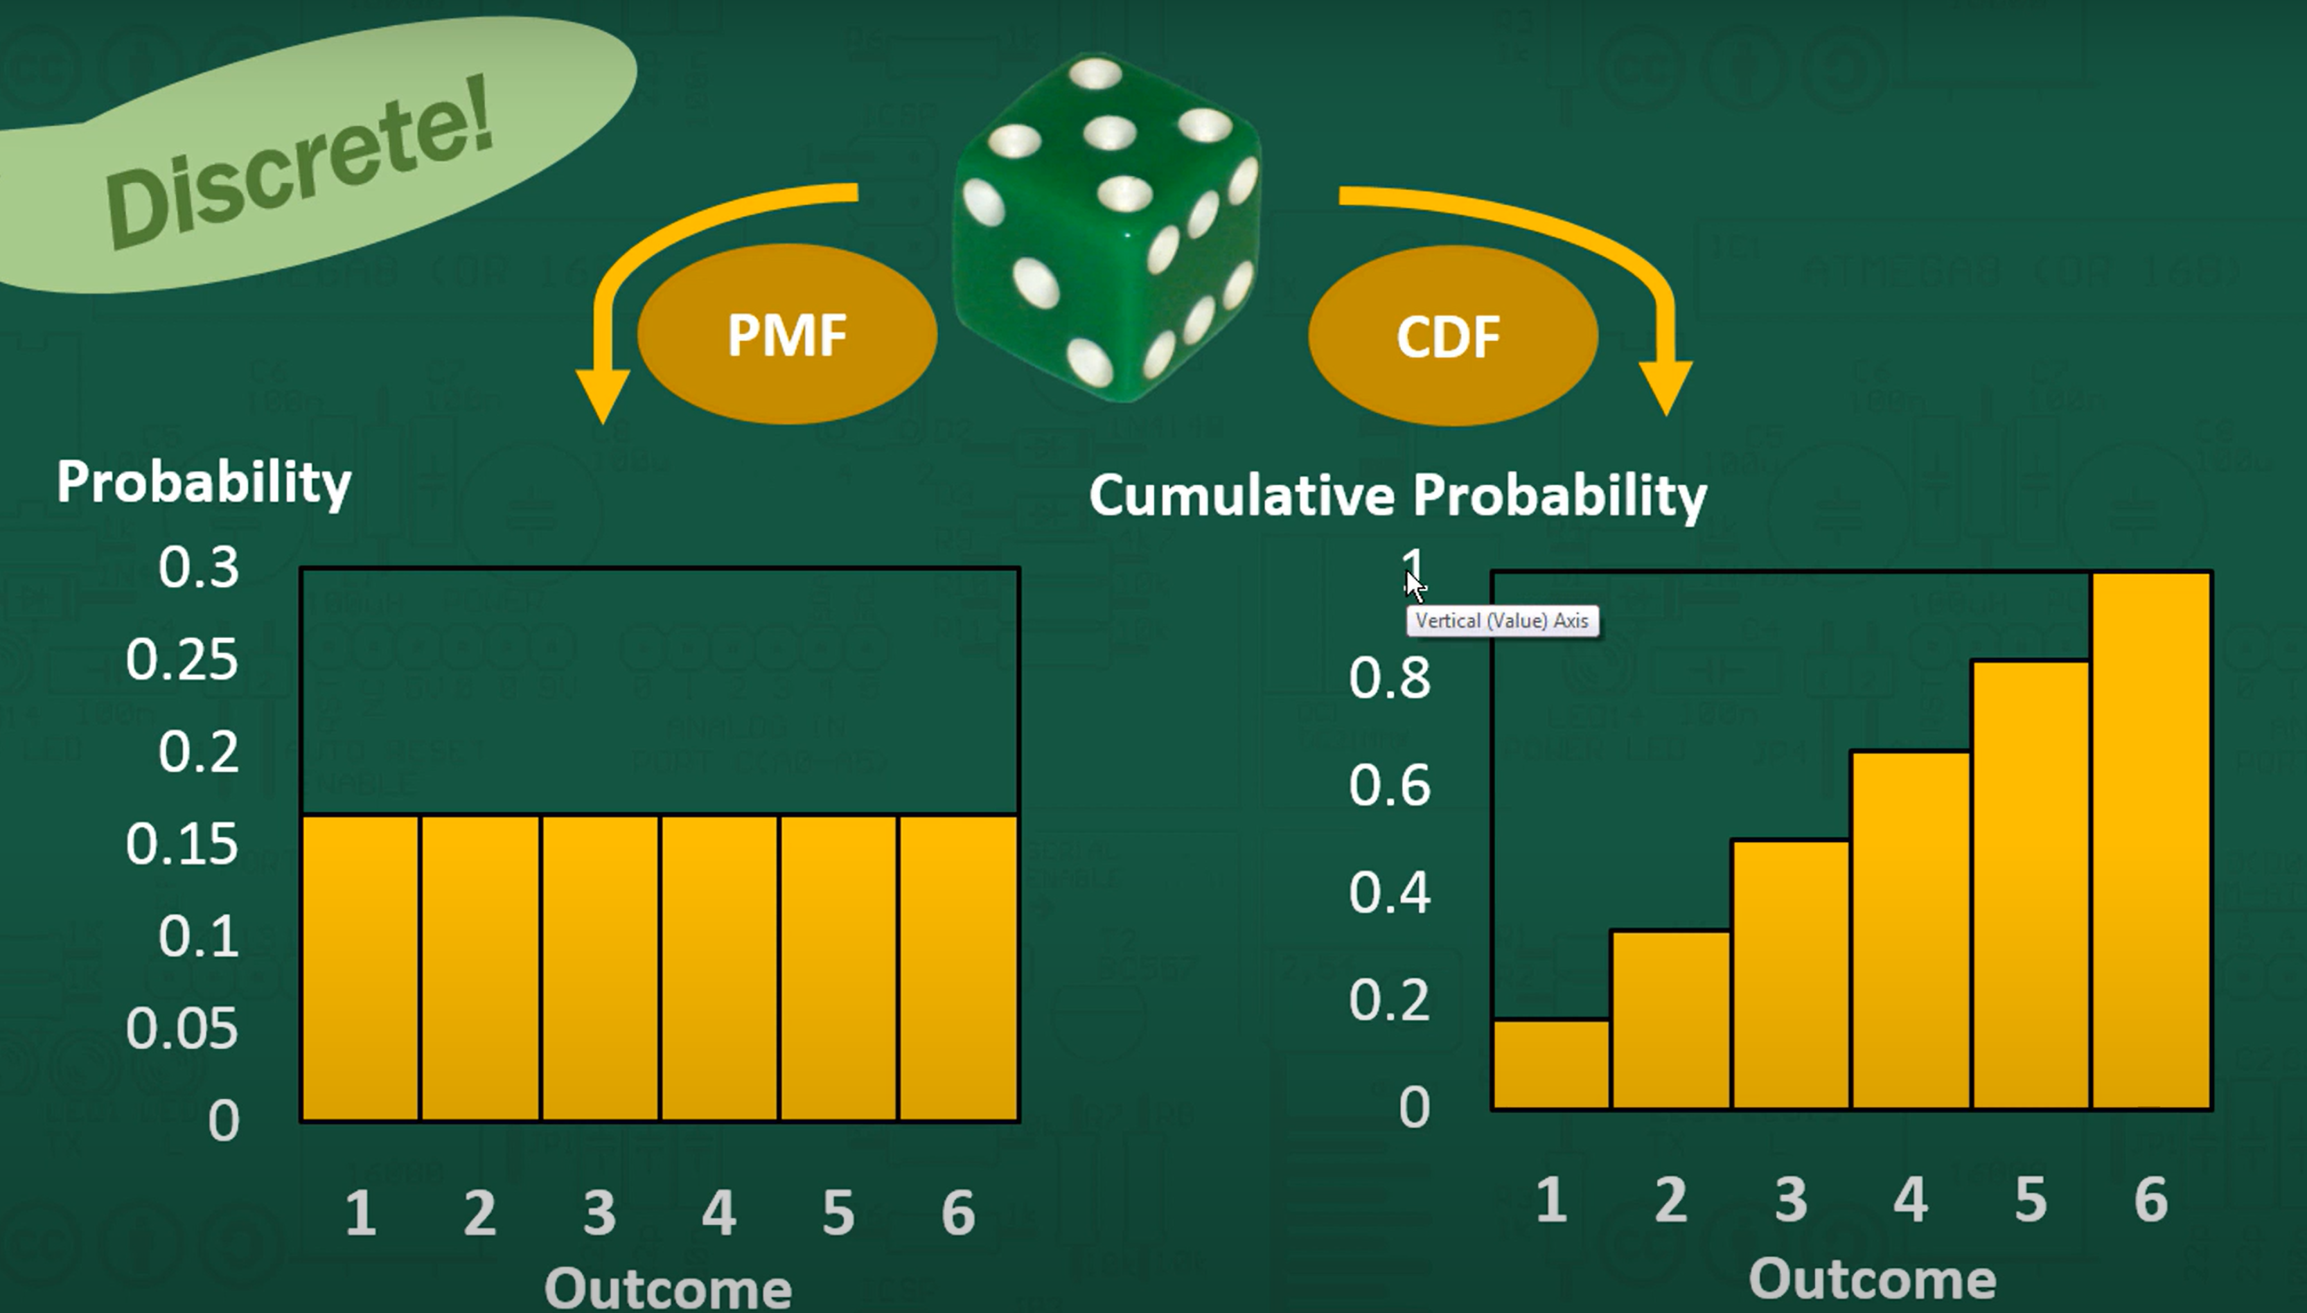
Cont…

Slide 36
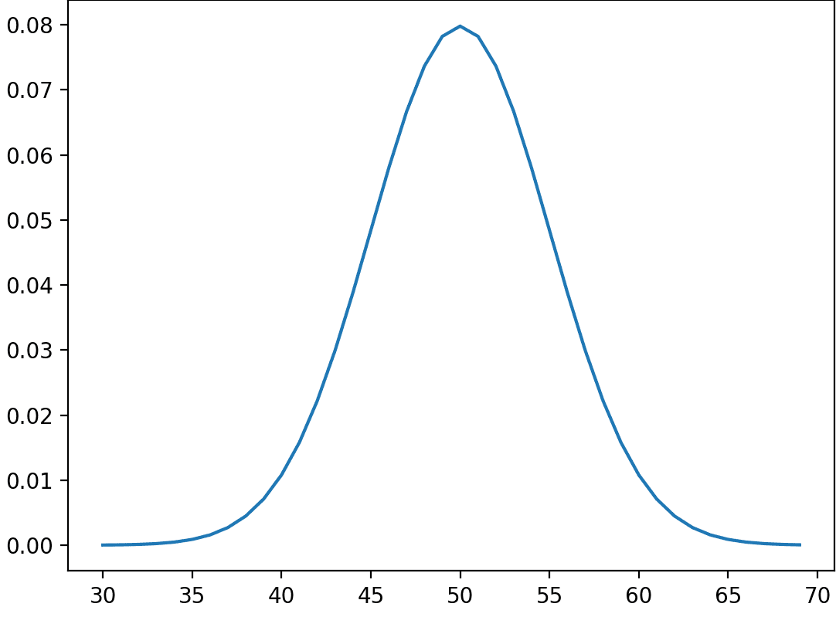
Cont…
Continuous Probability Distribution
In a continuous probability distribution, the random variable can take on an infinite number of values within a given range.
Probability Density Function (PDF): The PDF specifies the relative likelihood of the random variable falling within a range of values. Unlike the PMF, it doesn't provide probabilities for specific values but for ranges.
Example: The normal distribution, also known as the Gaussian distribution, is continuous. The PDF describes how likely it is for a continuous variable (e.g., height) to fall within a specific range of values.

Slide 37
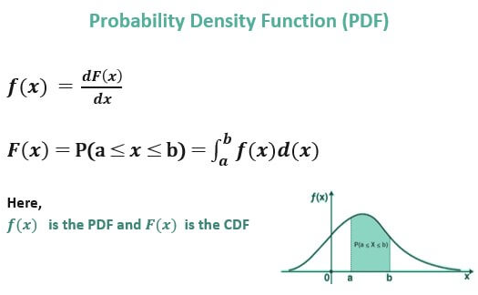
Cont…
Cont…
Probability Density Function (PDF)
The Probability Density Function (PDF) is a mathematical function used to describe the probability distribution of continuous random variables. Unlike the Probability Mass Function (PMF) for discrete random variables, the PDF does not provide probabilities for specific values but describes the relative likelihood of a continuous random variable falling within a range of values.

Slide 38
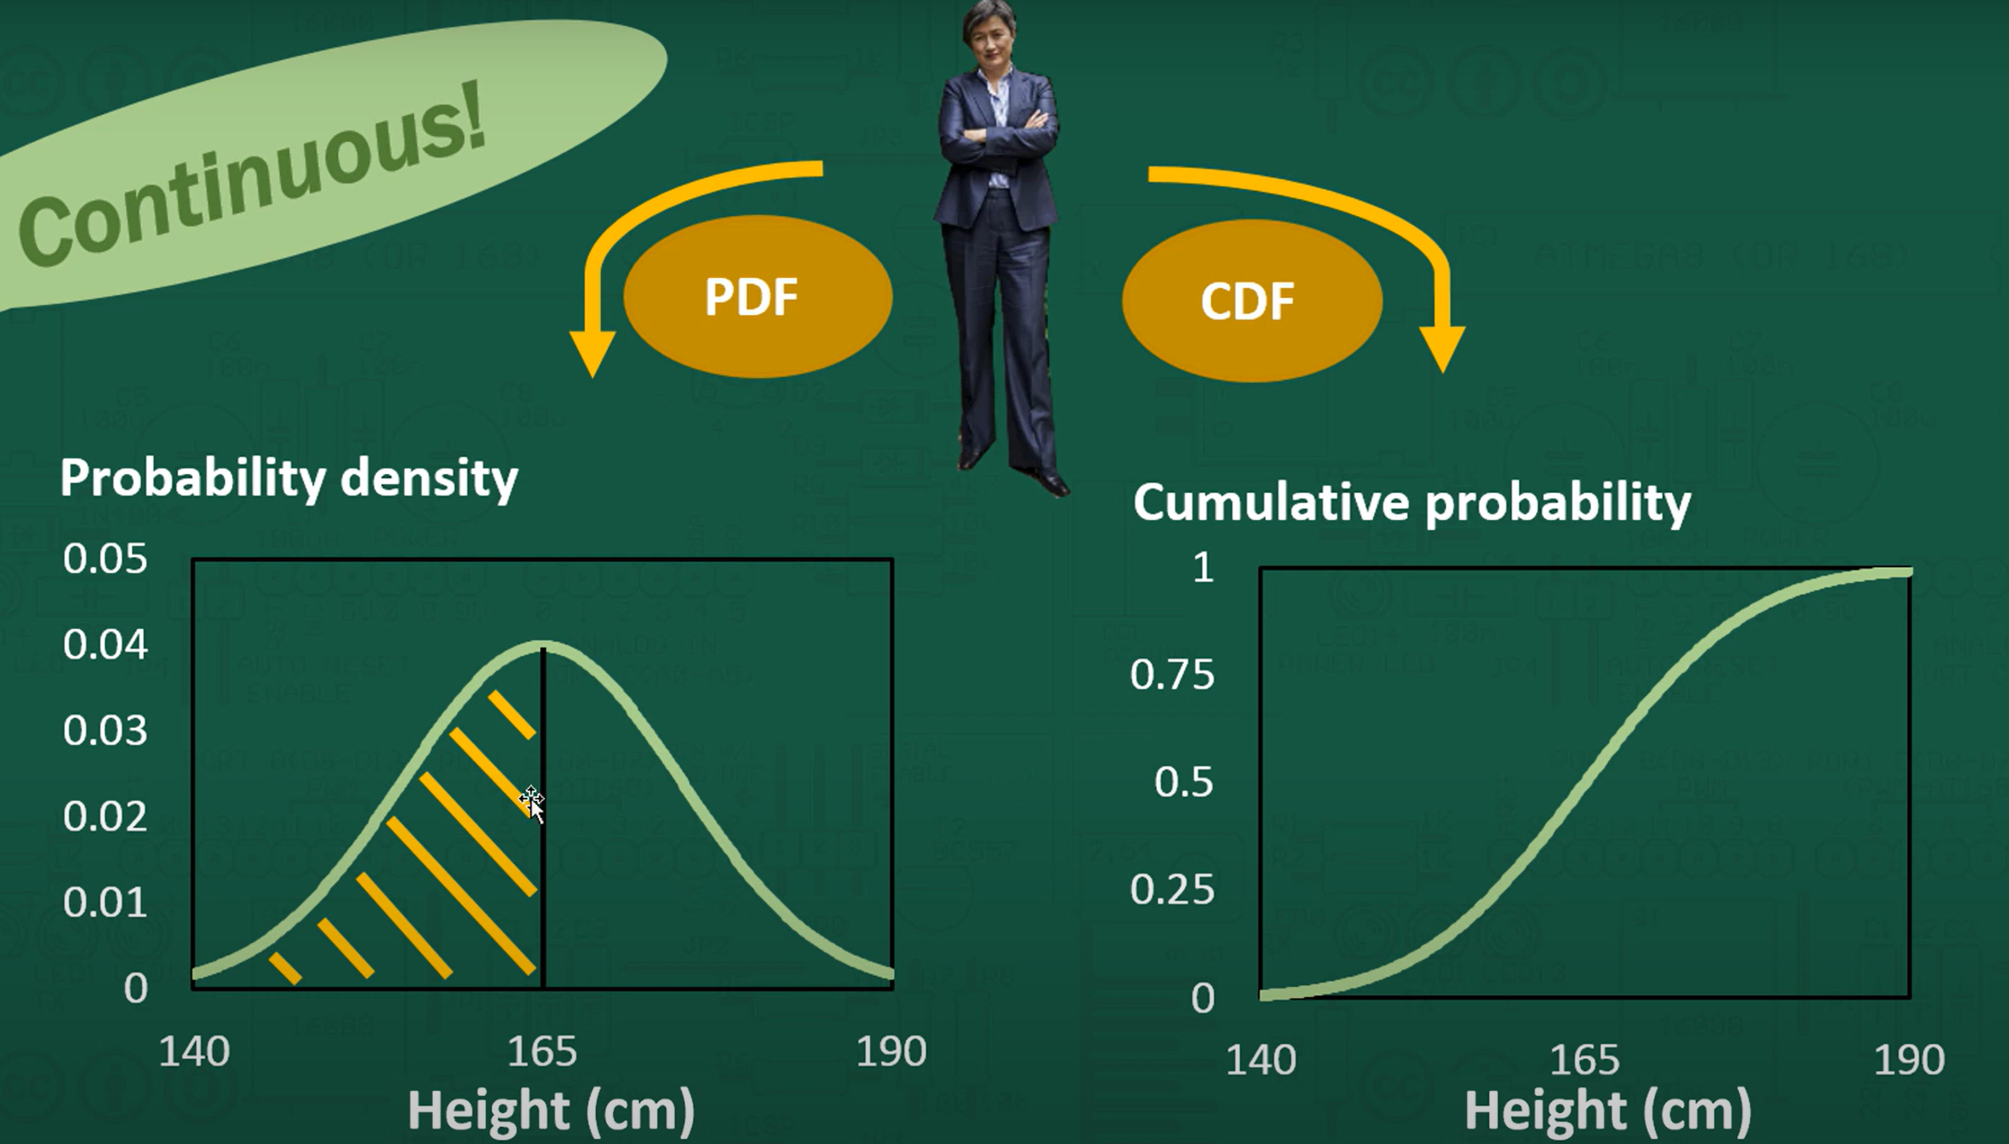
Cont…

Slide 39
Normal Distribution & Properties

Slide 40
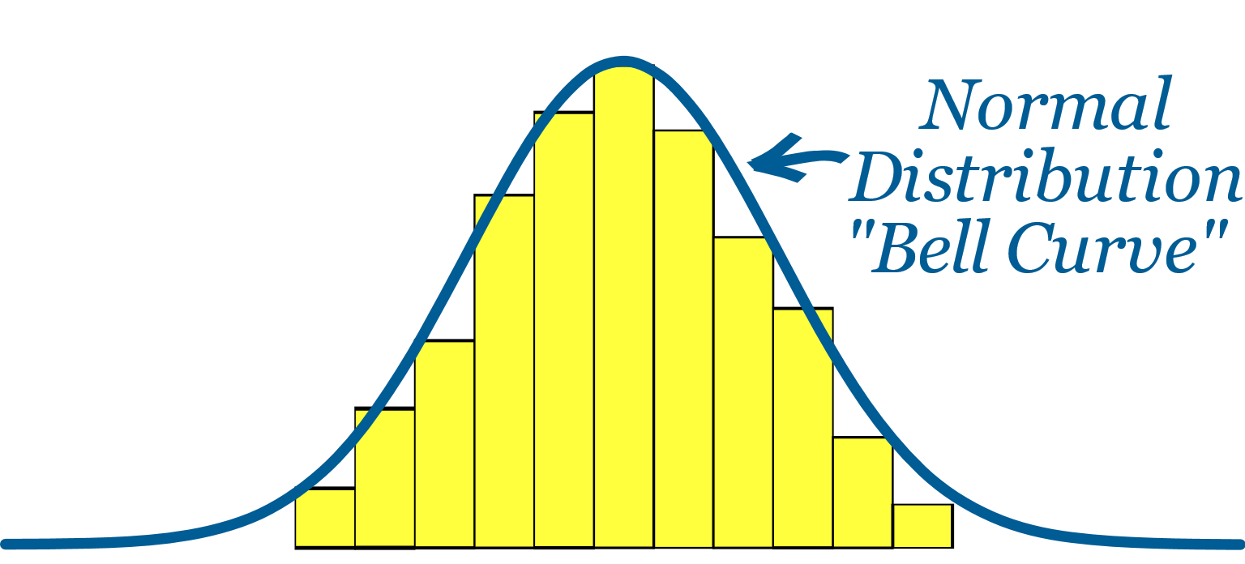
Normal Distribution
The normal distribution, also known as the Gaussian distribution or bell curve, is a fundamental probability distribution used in statistics and probability theory. It has several defining properties
Symmetry: It's symmetric, with equal likelihood on both sides of the mean.
Bell-shaped: It forms a bell-shaped curve, peaking at the mean.
Mean and Std. Deviation: Fully characterized by mean (μ) and standard deviation (σ).
Continuous: It's a continuous distribution, taking infinite values in a range.

Slide 41
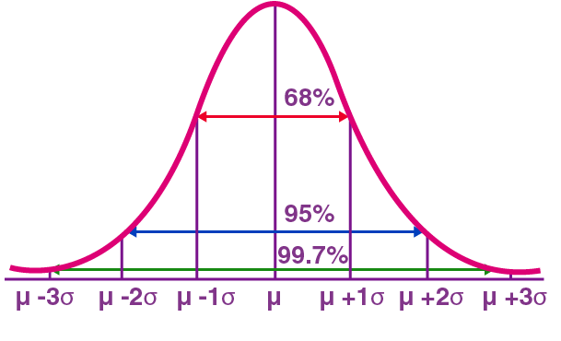
Normal Distribution
Empirical Rule
Using 1 standard deviation, the Empirical Rule states that,
Approximately 68% of the data falls within one standard deviation of the mean. (i.e., Between Mean- one Standard Deviation and Mean + one standard deviation)
Approximately 95% of the data falls within two standard deviations of the mean. (i.e., Between Mean- two Standard Deviation and Mean + two standard deviations)
Approximately 99.7% of the data fall within three standard deviations of the mean. (i.e., Between Mean- three Standard Deviation and Mean + three standard deviations)

Slide 42
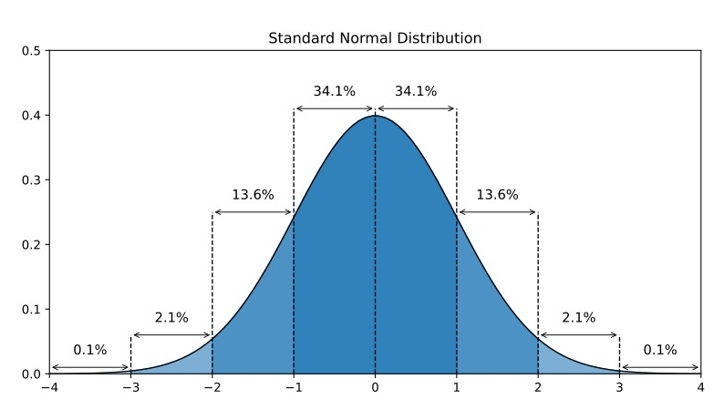

Standard Normal Distribution
The Standard Normal Distribution, also known as the Z-distribution, is a specific case of the normal distribution. It is characterized by the following:
Mean (μ): The mean of the standard normal distribution is 0.
Standard Deviation (σ): The standard deviation of the standard normal distribution is 1.
Shape: Like the normal distribution, it is symmetric and bell-shaped.
Notation: It is often denoted by the letter "Z.“
The standard normal distribution is extensively used in statistical analysis, hypothesis testing, and confidence interval calculations. Tables or calculators are available to find the probabilities associated with specific Z-scores, making it a valuable tool in statistics and data analysis.
$$z=\frac{x−μ}{σ}$$
where:
X is the individual value,
μ is the mean value,
σ is the standard deviation.

Slide 43
Cont...
Student | Exam Score
A | 80
B | 65
C | 90
D | 72
Student | Exam Score | Mean (μ) | Standard Deviation (σ) | Z-Score (Z)
A | 80 | 76.75 | 10 | (80 - 76.75) / 10 = 0.325
B | 65 | 76.75 | 10 | (65 - 76.75) / 10 = -1.175
C | 90 | 76.75 | 10 | (90 - 76.75) / 10 = 1.325
D | 72 | 76.75 | 10 | (72 - 76.75) / 10 = -0.475
for Student A, the Z-score is 0.325, indicating that their exam score is 0.325 standard deviations above the mean. For Student B, the Z-score is -1.175, indicating that their exam score is 1.175 standard deviations below the mean. Similarly, the Z-scores for Students C and D can be interpreted in the same way.
These Z-scores allow you to compare scores on a standardized scale and make statistical inferences about the distribution of exam performance in the class.

Slide 44

Central Limit Theorem & Its Importance

Slide 45
Central Limit Theorem
Central Limit Theorem
The Central Limit Theorem (CLT) is a fundamental concept in statistics that states the following:
“When independent random variables are added together, their properly normalized sum tends toward a normal distribution (a bell-shaped curve), regardless of the shape of the original random variables' distributions.”
In other words, as you take larger and larger samples from a population and calculate the means (or sums) of those samples, the distribution of those sample means will approach a normal distribution, even if the population itself is not normally distributed.

Slide 46
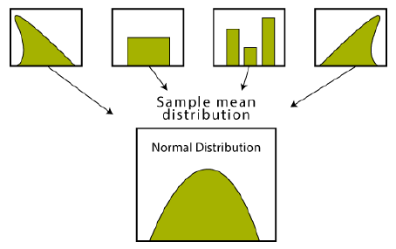
Cont…
Imagining an experiment may help you to understand sampling distributions:
Suppose that you draw a random sample from a population and calculate a statistic for the sample, such as the mean.
Now you draw another random sample of the same size, and again calculate the mean.
You repeat this process many times, and end up with a large number of means, one for each sample.
The distribution of the sample means is an example of a sampling distribution.
The central limit theorem says that the sampling distribution of the mean will always be normally distributed, if the sample size is large enough.
Regardless of whether the population has a normal, Poisson, binomial, or any other distribution, the sampling distribution of the mean will be normal.​

Slide 47
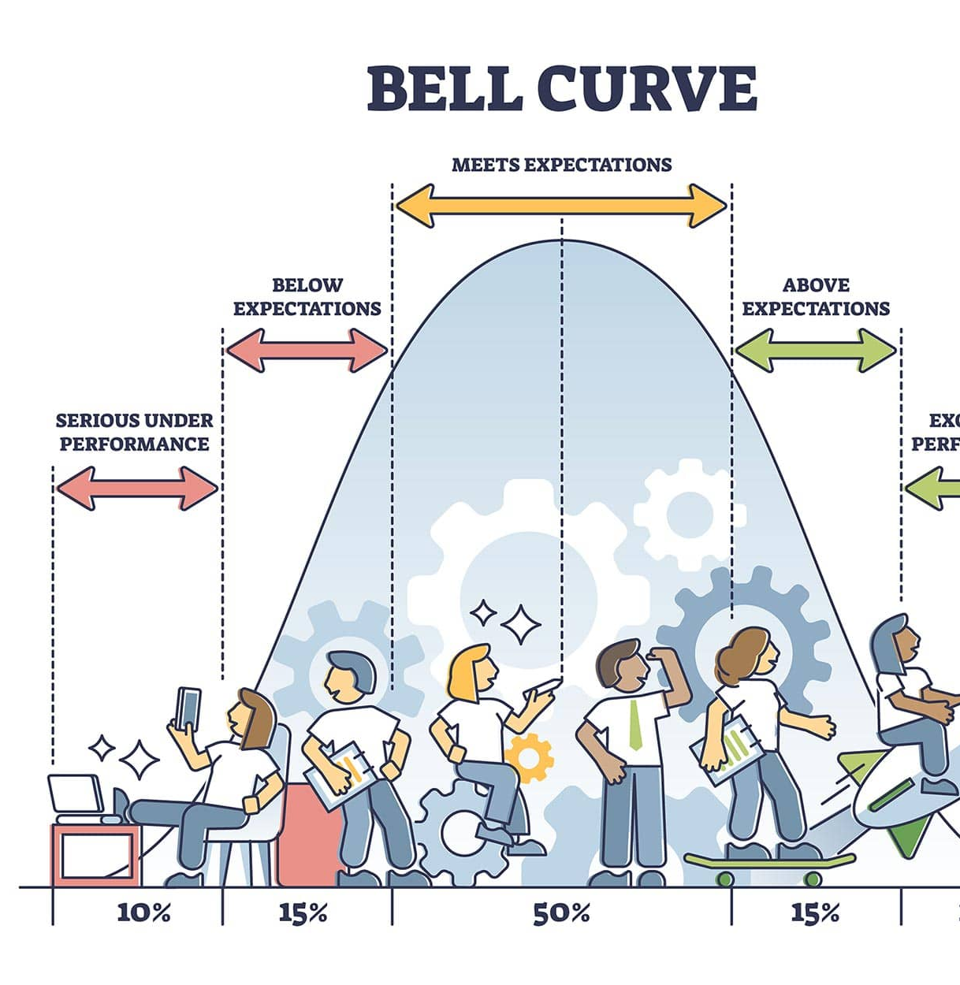
Skewness & T-distributions

Slide 48
Skewness
Skewness is a statistical measure that describes the asymmetry or lack of symmetry in the distribution of data. It quantifies the degree and direction of deviation from a perfectly symmetric distribution, such as a normal distribution.
Positive vs. Negative Skew
Positive Skew (Right Skew): In a positively skewed distribution, the tail on the right-hand side (the larger values) is longer or fatter than the left-hand side (the smaller values). The mean is typically greater than the median, and the distribution has a longer right tail.
Negative Skew (Left Skew): In a negatively skewed distribution, the tail on the left-hand side (the smaller values) is longer or fatter than the right-hand side (the larger values). The mean is typically less than the median, and the distribution has a longer left tail.

Slide 49
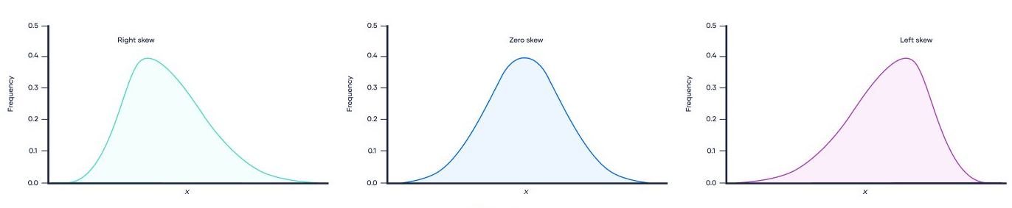
Cont….
Positive vs. Negative Skew
Positive Skew (Right Skew)
Negative Skew (Left Skew)

Slide 50
How skewness affects data interpretation
Skewness indicates the direction (positive or negative) of data imbalance.
It helps identify the presence of outliers or extreme values in the data.
Skewed data can impact the choice between mean and median as a measure of central tendency.
Skewness guides decisions on data transformation or analysis methods for more accurate insights.

Slide 51
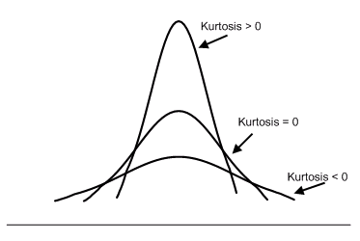
Kurtosis
Kurtosis is a statistical measure that quantifies the degree to which a probability distribution deviates from a normal distribution in terms of the shape and concentration of data in the tails. It provides insights into the presence of outliers and the "tailedness" of the distribution.
Mesokurtic: Similar to a normal distribution (kurtosis = 0).
Leptokurtic: Tails are fatter, and the central peak is higher (positive kurtosis or Kurtosis > 0).
Platykurtic: Tails are thinner, and the central peak is lower (negative kurtosis or Kurtosis < 0).
Kurtosis helps assess data's deviation from a normal distribution and its tendency toward extreme values.

Slide 52
T Distribution
A t-distribution, also known as Student's t-distribution, is a probability distribution that is used in statistics for making inferences about population means when the sample size is small, and the population's standard deviation is unknown.
Use in Hypothesis Testing
T-distributions are commonly used in hypothesis testing, particularly when:
The sample size is small (typically less than 30).
The population standard deviation is unknown.
The sample data follows an approximately normal distribution.
T-distributions provide critical values used to calculate confidence intervals and perform hypothesis tests for population means. The choice between using a t-distribution or a normal distribution depends on sample size and data characteristics.

Slide 53
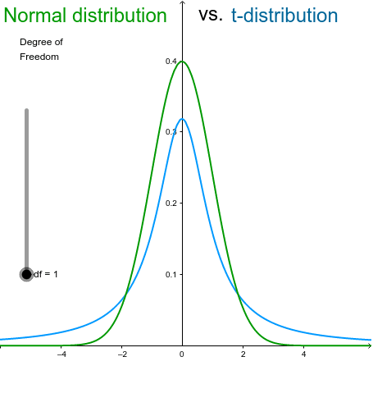
Cont…
Comparison with the Normal Distribution
T-distribution: Has heavier tails, which means it accommodates more extreme values and is better suited for small samples.
Normal distribution: Assumes a larger sample size and a known population standard deviation; it has thinner tails and is often used for larger samples.

Slide 54
Cont..
Example: T-Distribution for Small Sample Sizes
Suppose you're assessing a new teaching method's impact on student performance. With data from just 15 students, you calculate the sample mean and standard deviation.
Using a t-distribution
Compute a t-score based on the sample data.
Find the critical value from a t-table or calculator.
Construct a confidence interval or perform a hypothesis test to assess the teaching method's effectiveness.
T-distributions are crucial for small samples, accounting for uncertainty when estimating population parameters like the mean, making your analysis more accurate.

Slide 55
Questions ?

Slide 56
Thank You

